Slide 1

INT 249
System Administration
Lecture 0

Slide 2
Course details
LTP – 2 0 2
Text Books
THE OFFICIAL COMPTIA SERVER+ SELF-PACED STUDY GUIDE (EXAM SK0-005)
THE OFFICIAL COMPTIA LINUX+ INSTRUCTOR GUIDE (XK0-005)
References:
COMPTIA LINUX+ CERTIFICATION ALL-IN-ONE EXAM GUIDE: EXAM XK0-004

Slide 3
Course Outcomes
Through this course students should be able to
CO1 :: install and configure the server operating systems
CO2 :: manage users, groups permissions and ownerships
CO3 :: manage and implement storage solutions and networking
CO4 :: manage server operating systems’ boot process and system components

Slide 4
Program Outcomes as specific to the particular course
PO1::Apply the knowledge of mathematics, science, engineering fundamentals, and engineering specialization to the solution of complex engineering problems.
PO2::Identify, formulate, review research literature, and analyze complex engineering problems reaching substantiated conclusions using first principles of mathematics, natural sciences, and engineering sciences.
PO3::Design solutions for complex engineering problems and design system components or processes that meet the specified needs with appropriate consideration for public health and safety, and cultural, societal, and environmental considerations.
PO4::Use research-based knowledge and research methods including design of experiments, analysis and interpretation of data, and synthesis of the information to provide valid conclusions.

Slide 5
PO5::Create, select and apply appropriate techniques, resources, and modern engineering and IT tools including prediction and modeling to complex engineering activities with an understanding of the limitations.
PO6::Apply reasoning informed by the contextual knowledge to assess societal, health, safety, legal and cultural issues and the consequent responsibilities relevant to the professional engineering practice.
PO7::Apply ethical principles and commit to professional ethics and responsibilities and norms of the engineering practice.
PO8::Function effectively as an individual, and as a member or leader in diverse teams, and in multidisciplinary settings.
PO9::Communicate effectively on complex engineering activities with the engineering community and with society at large, such as, being able to comprehend and write effective reports and design documentation, make effective presentations, and give and receive clear instructions.

Slide 6
PO10::Demonstrate knowledge and understanding of the engineering and management principles and apply these to one’s own work, as a member and leader in a team, to manage projects and in multidisciplinary environments.
PO11::Recognize the need for, and have the preparation and ability to engage in independent and lifelong learning in the broadest context of technological change.

Slide 7
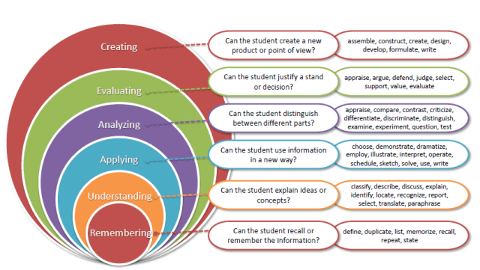
Revised Bloom’s Taxonomy

Slide 8
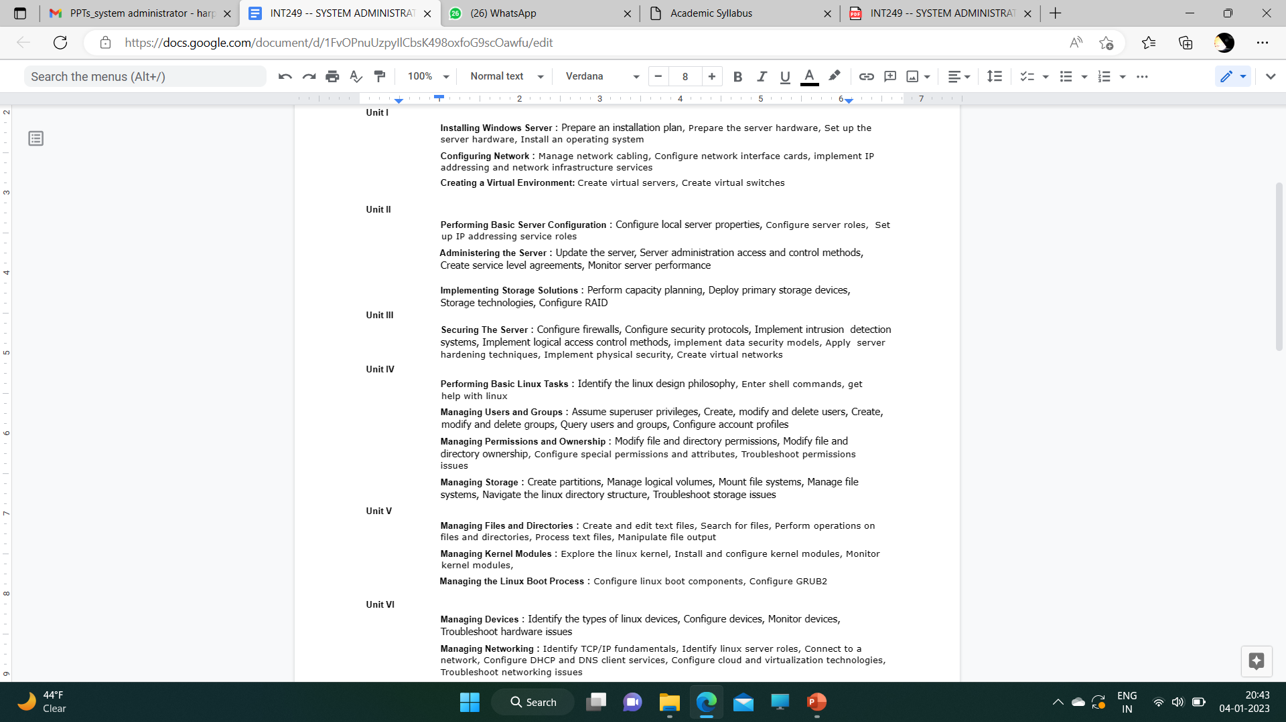
The course contents

Slide 9
Relevant References(Resources):
Prepare an installation plan, prepare the server hardware, set up the server hardware, install an operating system
Foundation Topics | Installing and Configuring Windows Server 2012 R2 | Pearson IT Certification
Configuring Network, manage network cabling, configure network ,Environment : create virtual servers, create virtual switches
Adding and Configuring Network Interface - Viewer Page | Infosys Springboard (onwingspan.com)
Administering the Server: update the server, server administration access and control methods
Install or Uninstall Roles, Role Services, or Features | Microsoft Learn
Perform capacity planning, deploy primary storage devices, storage technologies, configure RAID
The Course Overview - Viewer Page | Infosys Springboard (onwingspan.com)

Slide 10
Cont…
Securing The Server: configure firewalls, configure security protocols, implement intrusion detection systems
Configuring Firewalling - Viewer Page | Infosys Springboard (onwingspan.com)
Apply server hardening techniques, implement physical security, create virtual networks
Access Control Methods - Viewer Page | Infosys Springboard (onwingspan.com)
Performing Basic Linux Tasks : identify linux design philosophy, enter shell commands, get help with linux
The Design and Philosophy of Linux Operating System | by Jai Raheja | Medium
Managing Users and Groups : assume superuser privileges, create, modify and delete users, create, modify and delete groups,:
Basic Shell Commands in Linux - GeeksforGeeks
Linux Shell Commands - javatpoint
help Command in Linux with examples - GeeksforGeeks

Slide 11
Cont..
Troubleshoot permissions issues Managing Storage : create partitions, manage logical volumes, mount file systems, manage file systems, navigate the linux directory structure
How to create, delete, and modify groups in Linux | Enable Sysadmin (redhat.com)

Slide 12
Course Assessment Model
Marks break up
Attendance 5%
CA 25%
MTE 20%
ETE 50%
Total 100%
Three Class test – One before MTE and Two after MTE
CA 1-Scenario based questions(subjective questions)
CA 2- BYOD practical
CA 3- MCQs based questions

Slide 13
Recommended MOOCs course
Course code | Name of Mapped MOOC/Certification/Hackathon | Weblink | CA Benefit Count
INT249 | CompTIA Linux+ | https://www.comptia.org/certifications/linux | All CAs exempted
INT249 | CompTIA Server+ | https://www.comptia.org/certifications/server | All CAs exempted

Slide 14
Career prospects of System Adminstration
Server administrators
Database administrators
IT Managers
System administrators
Network professionals

